Slide 1
<20-Feb 2023>
Overview On Virtual Validation and Dependent Libraries
Abhishek U H

Slide 2
Simulator-Model Environment Critical Areas
What could be the possible blocks that you think that need a little attention for application like
VV Engine or any Simulator? !!!!
Defining Data – What data the application will work on!
Data loading – No Holes/padding .
Data Compatibility – Upward downward Compatibility.
Easy transfer of data – Data compression while transferring to file/ between process/dlls
Ease of Communication – No Data loss.
Ease at loading the dynamic modules – No difficulties in loading dlls
Easily available Libraries
OSI
Protocol buffers
ZMQ
FMI

Slide 3
Protocol Buffers
How is it helpful?
Let's say we have C-style structure, and we need to pass this structure data between the application and dll
Struct MySimpleStruct{
bool ready_flag;
int count;
};
Application
dll’s
IPC, threading, etc
MySimpleStruct mysimplestruct;
mysimplestruct.ready_flag = True;
Mysimplestruct.count = 30;
File
Dump
n/w transfer
You directly pass this buffer to dll as variable (copy) or you write to File dump that can be used later
Now there is extra 3 red box/memory that also goes into dlls and File dump/ network transfer.. Can we effectively serialize this into frame? As the size of struct increase so do extra red bytes. Why ?
1. Memory saving
2. With lesser memory usage, transfer becomes easier between dlls, files, network
Mysimplestruct
bool ---padding--- ---------int----------

Slide 4
Protocol Buffers
How is it helpful?
Say the structure size becomes in MBs then the holes/padded fields becomes more and if you log this continuously like we do in vehicle log, the size of file increases due to this extra bytes and end up increasing the storage memory, if stored. Sometimes the value of data may not require 4bytes to represent it, like in the example, value 30 can be represented by just one byte. effectively reducing it from 4 to 1bytes.
Now say you had to update the structure or insert the few variable in-between existing the structure member then this structure becomes incompatible with older one and you need to keep track of the structure. Also, the older log files becomes irrelevant.

Slide 5
Protocol Buffers
How to use it?
Protocol buffers provide a language-neutral, platform-neutral, extensible mechanism for serializing structured data in a forward-compatible and backward-compatible way.
Protocol buffers are a combination of the definition language (created in .proto files), the code that the proto compiler generates to interface with data, language-specific runtime libraries, and the serialization format for data that is written to a file or sent across a network connection
Step 1
Step 2
.cpp
file
Cpp Compiler(g++, VS)
.proto file
Protobuf Compiler
.exe
Protobuf language specific files
Protobuf language specific files
Protobuf language-specific libraries

Slide 6

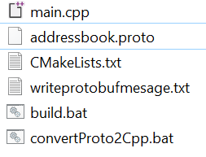
Protocol Buffers
Hands On Protocol buffers!!
Let's try to use protocol buffer compiler(protoc.exe) and let's use it in one simple application.
Example code folder structure

Slide 7
Open Simulation Interface- OSI
Environment Perception
What are the objects that you think off when you drive on roads and need to be considered while simulation?
Compact Car
Sedan
Truck
Bus
Pedestrian
Animals
Tram
Trains, etc
Moving Objects
Stationary Objects
Road Lanes
Lane boundaries Objects
Traffic Signs
Signs painted on Road (Road Marking)
Buildings
Trees
Poles
Bridge , etc
Drivable Lane
Paring lane
Cyclist/Pedestrian lane, etc
Solid line
Solid Dashed line
Curbstone
Guardrails, etc
No Parking
Pedestrian crossing
Humps ahead
Speed limits
One way, etc

Slide 8
Open Simulation Interface- OSI
Object Properties
Let's define object properties Moving Objects
Moving Object will have
Position
Velocity
Acceleration
Orientation
Orientation Rate
Classification
Dimension, etc
Thinking in 3D perspective
Position can be x, y, z
Even Velocity will be in x, y ,z
And others as well

Slide 9
Open Simulation Interface- OSI
Overview
ASAM OSI is a specification for interfaces between models and components of a distributed simulation environment description that uses the message format of the Protocol Buffer library.
OSI is strongly focused on the environmental perception of automated driving functions
The complexity of automated driving functions is rapidly increasing, which means the requirements for testing and development methods are growing too. Testing in virtual environments makes it possible to control and reproduce environment conditions.
OSI permits easy and straight-forward compatibility between automated driving functions and the variety of driving-simulation frameworks that are available. OSI defines generic interfaces to ensure the modularity, integrability, and interchangeability of the individual components.

Slide 10
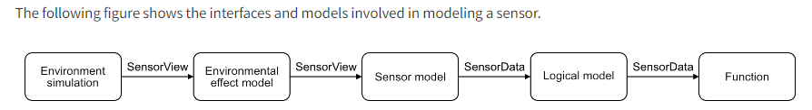
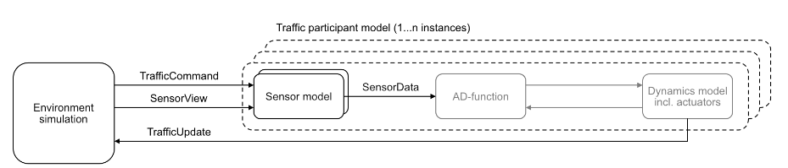
Open Simulation Interface- OSI
Overview
OSI contains an object-based environment description that uses the message format of the Protocol Buffer library
OSI also defines interfaces for traffic participant models. The TrafficCommand interface makes it possible to send commands to traffic participant models. The TrafficUpdate interface makes it possible to receive the updated state from traffic participant models.

Slide 11
Open Simulation Interface- OSI
Overview
Top-level interfaces
Ground truth
Feature data
Sensor view
Sensor-view configuration
Sensor data
Traffic command
Traffic update
SensorView
Ground truth
SensorData
Sensor view
Feature data

Slide 12
Open Simulation Interface- OSI
Overview
Lets dig some OSI .proto files and see how that looks
https://github.com/OpenSimulationInterface/open-simulation-interface

Slide 13
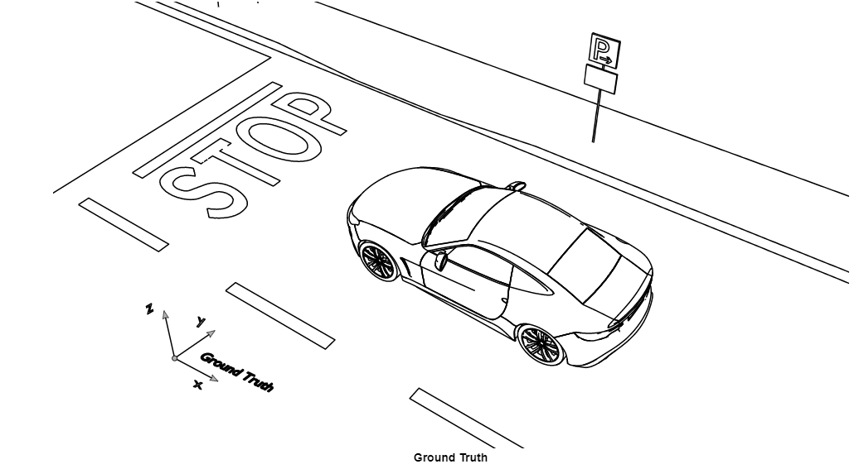
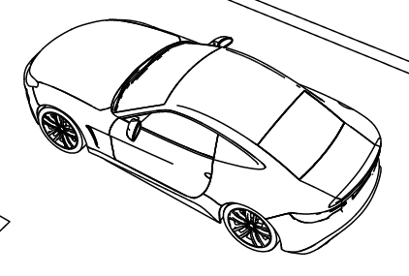
Open Simulation Interface- OSI
Co-Ordinate System
Global Co-ordinate System:
Coordinate system for all entities that are part of ground truth. The global coordinate system is an inertial x/y/z-coordinate system. The origin is the global reference point that is determined by the environment simulation. This reference point may be derived from map data or other considerations. Global coordinates can be mapped to a geographic coordinate system via osi3::GroundTruth::proj_string.

Slide 14
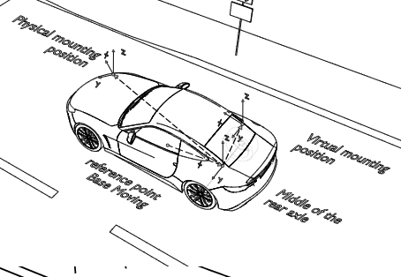
Open Simulation Interface- OSI
Co-Ordinate System
Object Co-ordinate System:
Local object coordinate system. The origin of the corresponding coordinate system is not necessarily identical to the center of the object’s bounding box. If the origin of the corresponding coordinate system is not identical to the center of the object’s bounding box, the object documentation will provide the actual definition.

Slide 15
Open Simulation Interface- OSI
Co-Ordinate System
Sensor Co-ordinate System:
Coordinate system for all entities that are part of sensor data. The origin is the mounting position of the physical sensor or a virtual mounting position, depending on the OSI message.
Note that host local co-ordinates are different for OSI and Aptiv Co-ordinate. +Y is on left hand side

Slide 16
Open Simulation Interface- OSI
Scenario/Scene Storage
There are 3 OSI file type that can be used for storing the OSI messages/frames
*.osi
Binary trace file. Messages are separated by a length specification before each message. The length is represented by a four-byte, little-endian, unsigned integer. The length does not include the integer itself.
*.txt
Plain-text trace file. Messages are separated by $$__$$.
*.txth
Human-readable plain-text trace file. Messages are separated by newlines. These files may be used for manual checks.

Slide 17
Open Simulation Interface- OSI
Reference
OSI class list
https://opensimulationinterface.github.io/open-simulation-interface/annotated.html
OSI git repo
https://opensimulationinterface.github.io/open-simulation-interface/index.html

Slide 18
Functional Mock-Up Interface - FMI
How is it helpful?
Consider from OEM perspective or from system level integrator, your task will be to import each simulation model that was shared by each supplier to your simulator.
Now, it is not necessary that the supplier uses the same simulation environment (like MATLAB) as OEM/system. Even if supplier uses the same environment there will not be same API’s which will be exposed for simulator for simulation.
Also, the supplier could be providing a subsystem (more than one controller model) for simulation or a single controller model for the simulator. The job of integrator becomes tedious handling everything!!
FMI takes care of all the mentioned issue + more!!!
Also, the exported models (FMU) can be manually generated or from the supplier simulation environment tools(like MATLAB)

Slide 19
Functional Mock-Up Interface - FMI
What is FMI?
The Functional Mock-up Interface (FMI) is a free standard from MAC that defines a container i.e., zip file and an interface i.e., APIs to exchange dynamic models using a combination of XML files, binaries and C code, distributed as a ZIP file
The APIs is used by a simulation environment, the importer, to create one or more instances of an FMU and to simulate them, typically together with other models
Almost all the simulation software are accepting the FMU standards - Matlab , dSpace to name few

Slide 20
Functional Mock-Up Interface - FMI
Overview:
The FMI standards defines three interface types:
Co-Simulation (CS) where the FMU typically contains its own solver or scheduler,
Model Exchange (ME) that requires the importer to perform numerical integration, and
Scheduled Execution (SE) where the importer triggers the execution of the model partitions.
All Interface types introduced in previous point, uses some common concept.
FMI Application Programming Interface (C)
FMI Description Schema (XML)
FMU Distribution (ZIP)
Let's see what each Interface means in FMI !!!

Slide 21
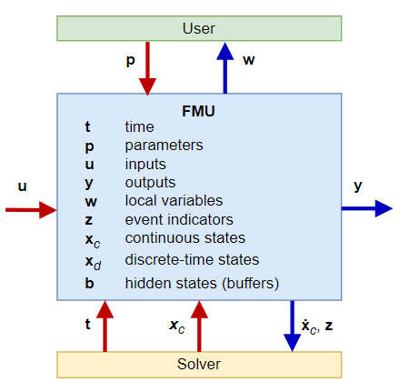
Functional Mock-Up Interface - FMI
FMI for Model Exchange (ME)
FMI for Model Exchange provides a standardized interface for solving ordinary differential equations with events. A Model Exchange FMU implements the model algorithm only without the required solution
Models are described by differential, algebraic and discrete equations with time-, state- and step-events
FMI for Model Exchange :

Slide 22
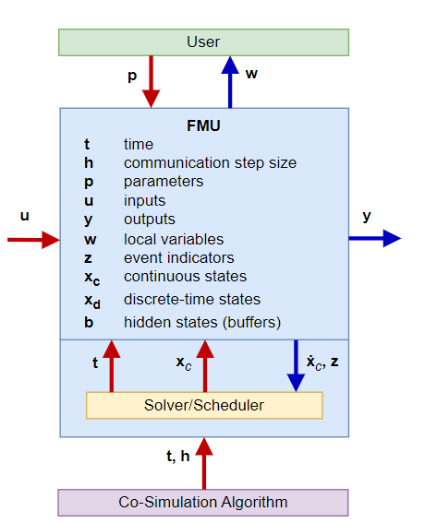
Functional Mock-Up Interface - FMI
FMI for Co-Simulation (CS)
The Co-Simulation interface is designed both for the coupling of simulation tools, and the coupling of subsystem models, exported by a modeling environment together with their solvers as runnable code

Slide 23
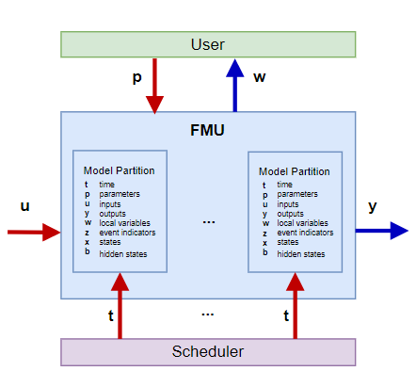
Functional Mock-Up Interface - FMI
FMI for Scheduled Execution (SE)
The Scheduled Execution interface exposes individual model partitions. A scheduler provided by the importer can control the execution of each model partition separately.

Slide 24

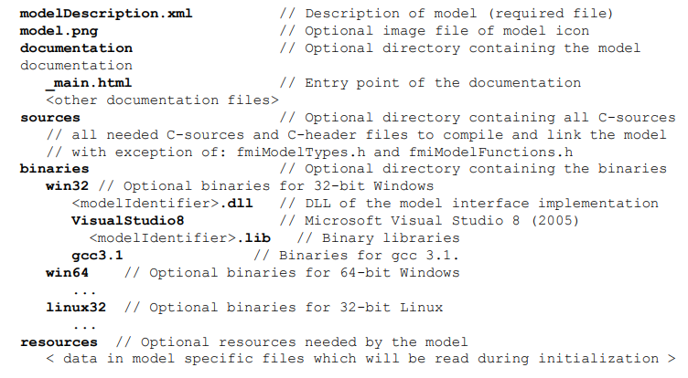
Functional Mock-Up Interface - FMI
FMI - Distribution of Model
SenorModel.fmu
This Photo by Unknown Author is licensed under CC BY-NC-ND

Slide 25
Functional Mock-Up Interface - FMI
Sample FMI Description Schema (XML)

Slide 26
Functional Mock-Up Interface - FMI
Common Concept
Requirements for Implementations of the C-API
Need not be thread safe
Callback functions passed should not be from other FMU
Function should not change global settings/other thread objects
Function argument should not be NULL until specified
Standard as such doesn’t provide any options for portability.
Header Files and Naming of Functions
The FMI C-API is defined by three C99 header files
All function declarations and type definitions in these header files have the prefix fmi3.
fmi3PlatformTypes.h ->
fmi3FunctionTypes.h ->
fmi3Functions.h ->
typedef double fmi3Float64;
typedef fmi3Status fmi3SetTimeTYPE(fmi3Instance instance, fmi3Float64 time);
FMI3_Export fmi3SetTimeTYPE fmi3SetTime;

Slide 27
Functional Mock-Up Interface - FMI
Common Concept
Status Returned by Functions
fmi3OK,
fmi3Warning,
fmi3Discard,
fmi3Error,
fmi3Fatal,
Advancing Time
In Model Exchange, time is under the sole control of the importer and its integration algorithm. The model itself receives the current time to be used in its computation with fmi3SetTime.
In Co-Simulation, time advances in (possibly variable) steps negotiated between the co-simulation algorithm of the importer and the FMU
In Scheduled Execution, just like in Model Exchange, time is under the sole control of the importer i.e. its scheduler

Slide 28
Functional Mock-Up Interface - FMI
Common Concept
Variables
FMU and importer use variables to exchange information. All variables are listed in modelDescription.xml as elements of <fmiModelDescription><ModelVariables>.
Getting and Setting Variable Values -array
<Float64 name="A" valueReference="2" causality="parameter" variability="tunable"
start="0.0 0.1 1.0 1.1 2.0 2.1"> <Dimension start="3"/> <Dimension start="2"/> </Float64>
typedef fmi3Status fmi3Set/GetFloat32TYPE(fmi3Instance instance,
const fmi3ValueReference valueReferences[],
size_t nValueReferences,
fmi3Float32 values[],
size_t nValues);

Slide 29
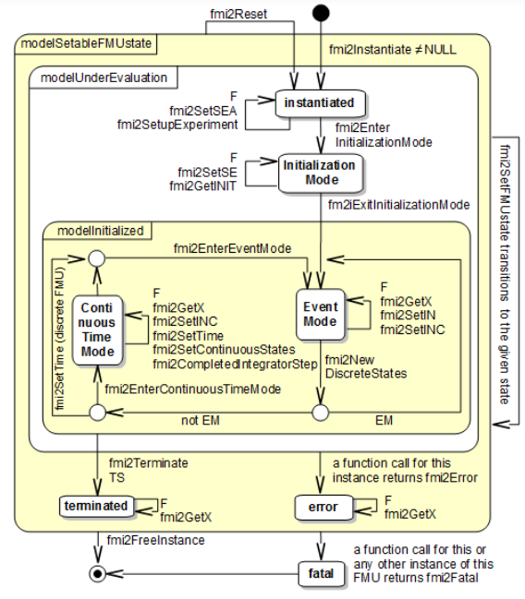
Functional Mock-Up Interface - FMI
Model Exchange -Call Sequence State Machine

Slide 30
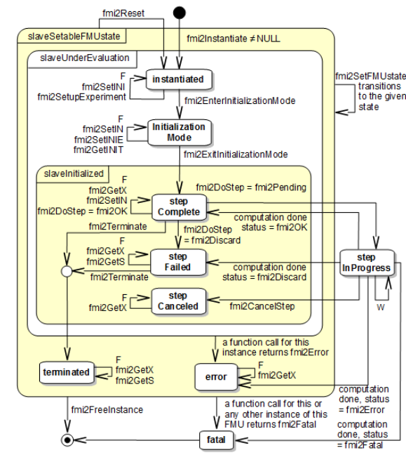
Functional Mock-Up Interface - FMI
Co Simulation-Call Sequence State Machine

Slide 31
Functional Mock-Up Interface - FMI
Common Concept
https://fmi-standard.org/docs/3.0/#table-subscripts
https://fmi-standard.org/docs/3.0/#fmi-for-model-exchange
https://fmi-standard.org/docs/3.0/#fmi-for-co-simulation
https://fmi-standard.org/docs/3.0/#fmi-for-scheduled-execution

Slide 32
ZMQ - Introduction
ZeroMQ (also spelled ØMQ, 0MQ or ZMQ) is a high-performance asynchronous messaging library, aimed at use in distributed or concurrent applications
ZeroMQ supports common messaging patterns (pub/sub, request/reply, client/server and others) over a variety of transports (TCP, in-process, inter-process, multicast, WebSocket and more), making inter-process messaging as simple as inter-thread messaging
Why needed ??? One, to solve the general problem of “how to connect any code to any code, anywhere”. Two, to wrap that up in the simplest possible building blocks that people could understand and use easily.

Slide 33
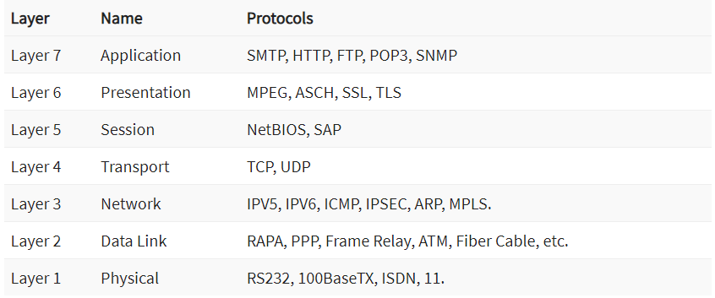
ZMQ – where does ZMQ fit in OSI model?
Implemented by libZMQ
All connected nodes must be ZMQ
We cannot use normal TCP socket to connect to ZMQ socket
ZMTP
TCP

Slide 34
ZMQ – Different Socket
ZeroMQ differs in the way its sockets work. Unlike the synchronous way the regular sockets work, ZeroMQ’s socket implementation “present an abstraction of an asynchronous message queue”.
The way these sockets work depend on the type of socket chosen. And flow of messages being sent depend on the chosen patterns, of which there are four:
Request/Reply Pattern: Used for sending a request and receiving subsequent replies for each one sent.
Publish/Subscribe Pattern: Used for distributing data from a single process (e.g. publisher) to multiple recipients (e.g. subscribers).
Pipeline Pattern: Used for distributing data to connected nodes.
Exclusive Pair Pattern: Used for connecting two peers together, forming a pair.
ZeroMQ offers four different types of transport for communication. These are:
In-Process (INPROC): Local (in-process) communication transport.
Inter-Process (IPC): Local (inter-process) communication transport.
TCP: Unicast communication transport using TCP.
PGM: Multicast communication transport using PGM.

Slide 35
ZMQ – Communication Setup Example
1. ZMQ tcp socket with Request/Reply Pattern
Server code:
import time
import zmq
context = zmq.Context()
socket = context.socket(zmq.REP)
socket.bind("tcp://*:5555")
while True:
# Wait for next request from client
message = socket.recv()
print("Received request: %s" % message)
# Do some 'work'
time.sleep(1)
# Send reply back to client
socket.send(b"Hello")
Client code:
import zmq
context = zmq.Context()
# Socket to talk to server
print("Connecting to hello world server…")
socket = context.socket(zmq.REQ)
socket.connect("tcp://localhost:5555")
# Do 10 requests, waiting each time for a response
for request in range(10):
print("Sending request %s …" % request)
socket.send(b"Hello")
# Get the reply.
message = socket.recv()
print("Received reply %s [ %s ]" % (request, message))

Slide 36
ZMQ – Communication Setup Example
2. ZMQ tcp socket with Pub-Sub Pattern
Publisher code:
import zmq
import time
# ZeroMQ Context
context = zmq.Context()
# Define the socket using the "Context"
sock = context.socket(zmq.PUB)
sock.bind("tcp://127.0.0.1:5680")
id = 0
while True:
time.sleep(1)
id, now = id+1, time.ctime()
# Message [prefix][message]
message = "1-Update! >> #{id} >> {time}".format(id=id, time=now)
sock.send(message)
# Message [prefix][message]
message = "2-Update! >> #{id} >> {time}".format(id=id, time=now)
sock.send(message)
id += 1
Subscriber code:
import zmq
# ZeroMQ Context
context = zmq.Context()
# Define the socket using the "Context"
sock = context.socket(zmq.SUB)
# Define subscription and messages with prefix to accept.
sock.setsockopt(zmq.SUBSCRIBE, "1")
sock.connect("tcp://127.0.0.1:5680")
while True:
message= sock.recv()
print message

Slide 37
ZMQ – Reference Links
https://zeromq.org/get-started/
https://zguide.zeromq.org/
https://www.digitalocean.com/community/tutorials/how-to-work-with-the-zeromq-messaging-library#about

Slide 38
Thank you.

